Slide 1

Presence-Sensor, aber richtig
Aqara FP2
https://www.amazon.de/Aqara-PS-S02E-Anwesenheitssensor-FP2/dp/B0BXWZMQJ3

Slide 2
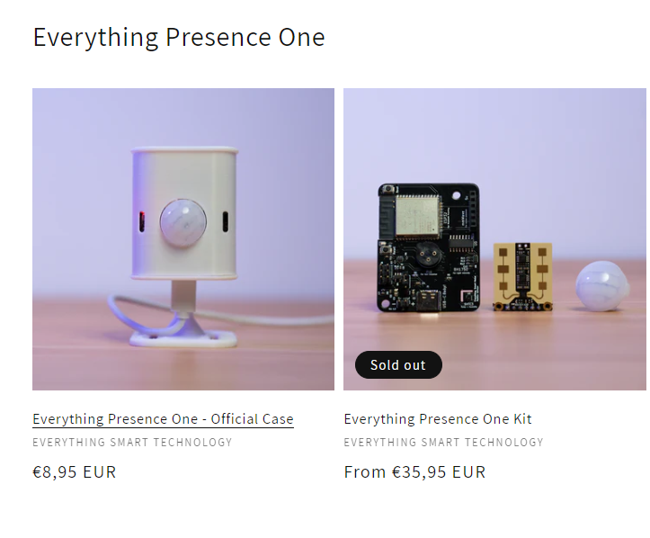
EP1

Slide 3
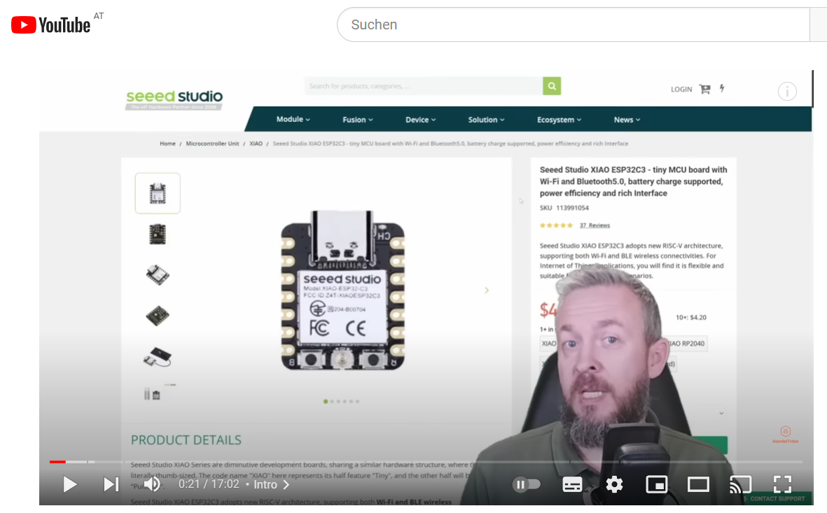
BearedTinker
https://www.youtube.com/watch?v=KMopR2zANDc&ab_channel=BeardedTinker

Slide 4
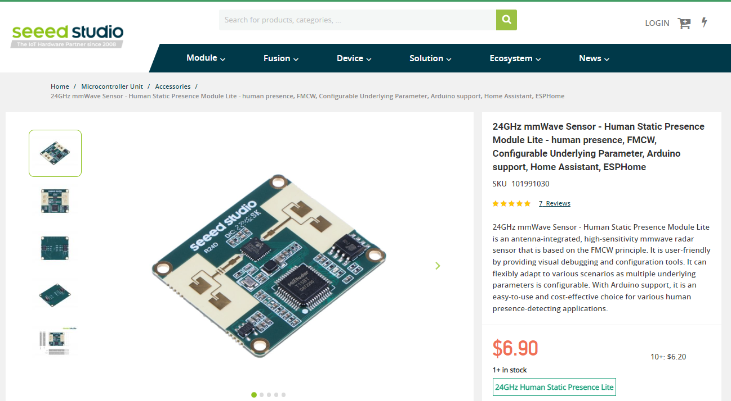
24GHz mmWave Sensor

Slide 5
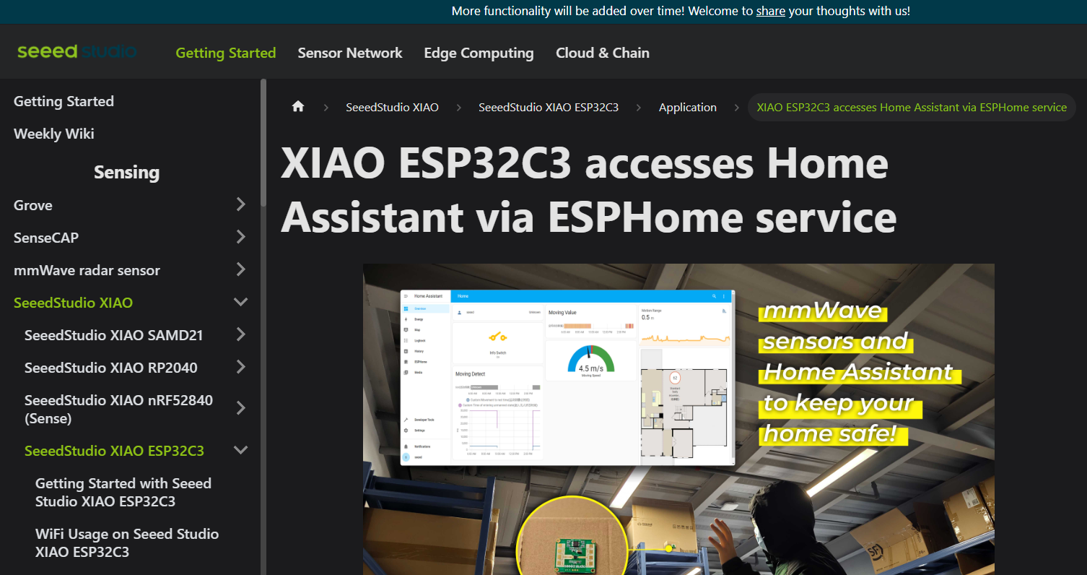
Integration über ESPHome

Slide 6
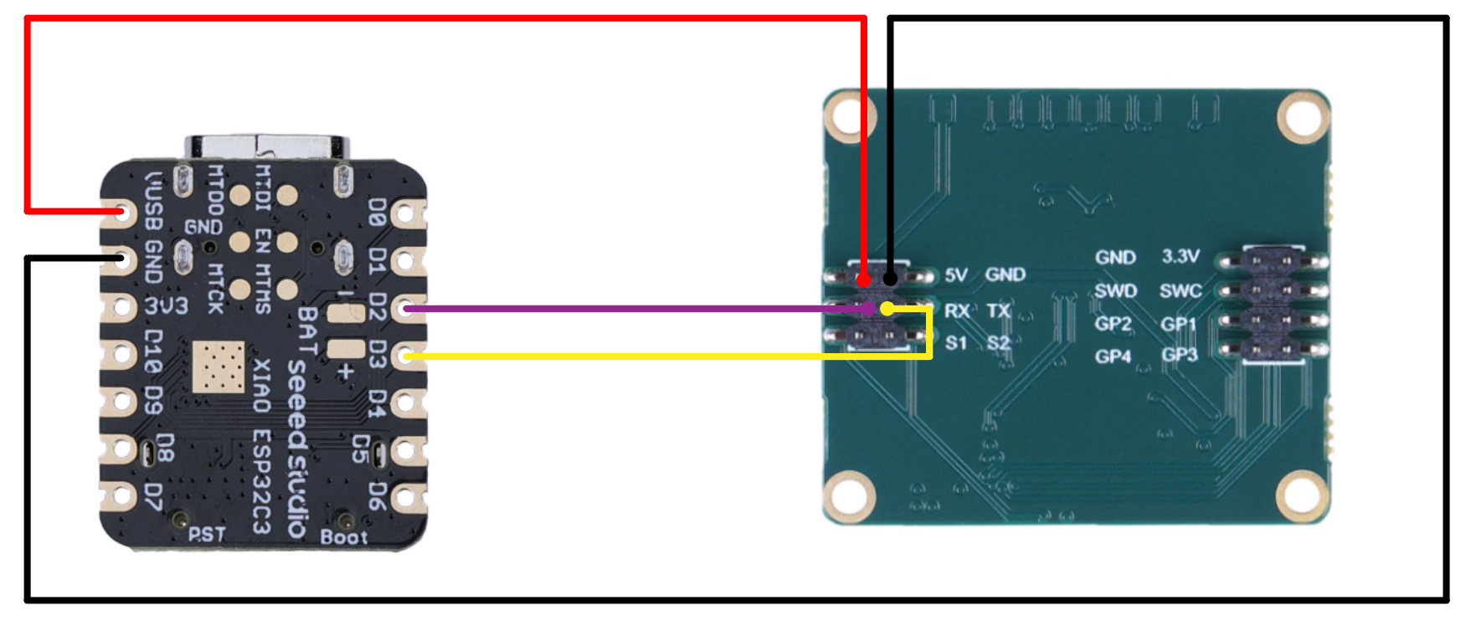
Verkabelung

Slide 7
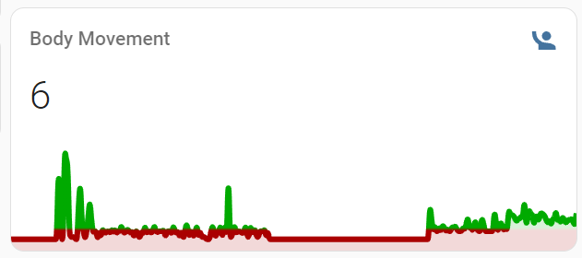
Ergänzung zu PIR

